Slide 6
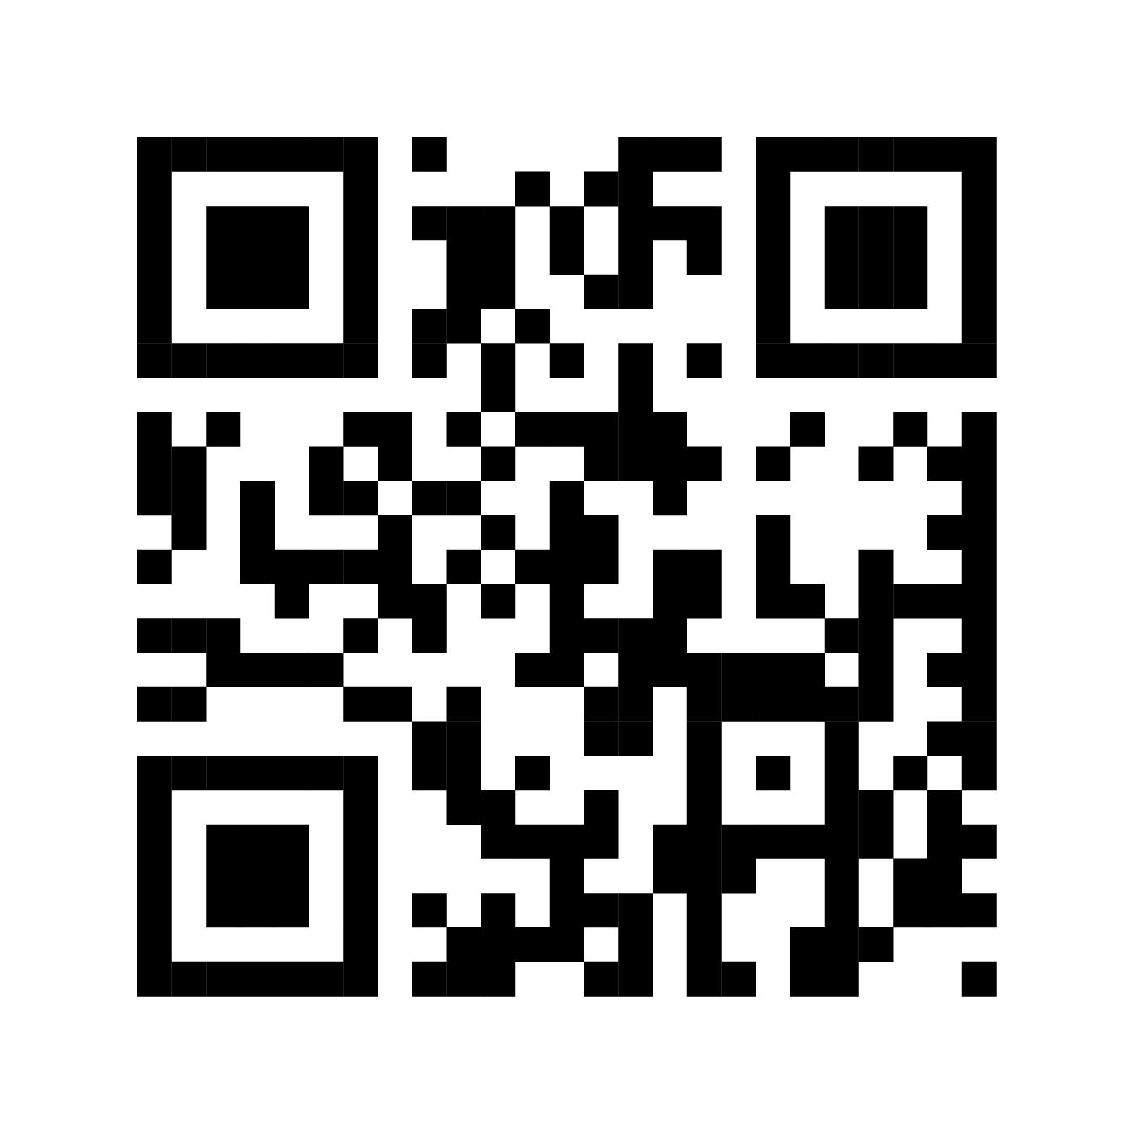
Thank You for Attending!
Please take the session survey in the conference app!
www.aises.org/app

